Slide 1


Clean Air &
Safe Routes 4 Schools
Learn about Air Pollution

Slide 2
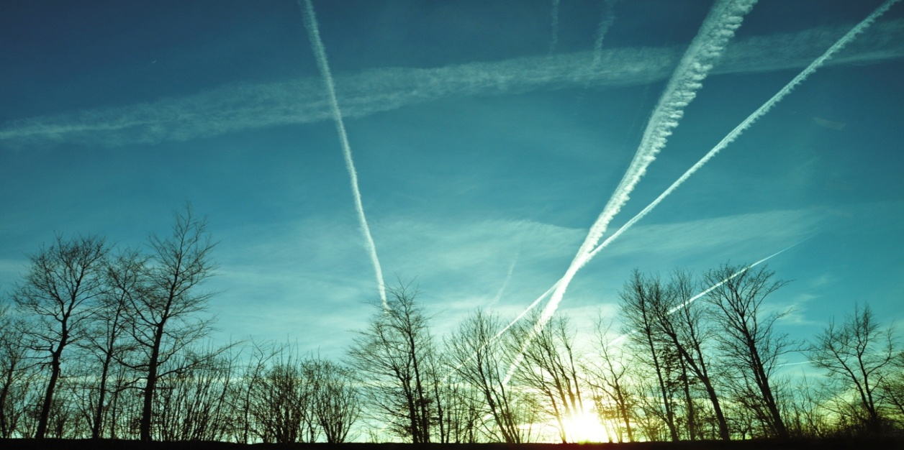
Outline
What is air pollution?
What makes air dirty?
Air Pollution today
Air Pollution and our health
What are the pollutants?
Where are the pollutants?
Make our air cleaner!

Slide 3
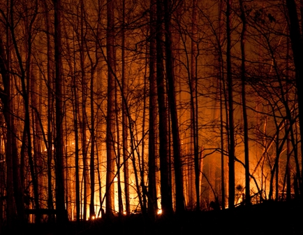
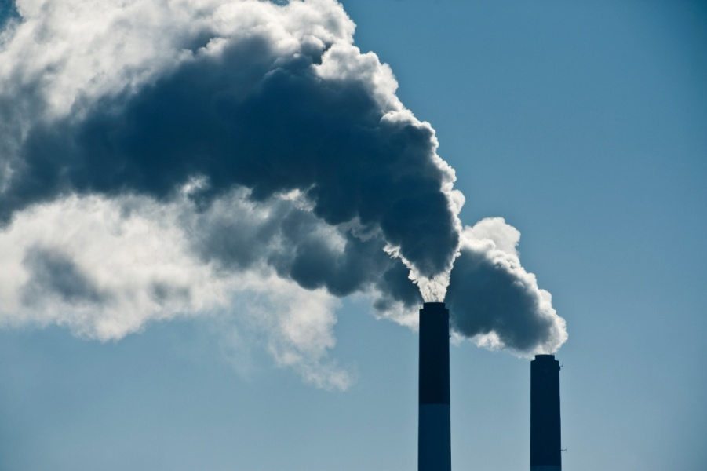
What is air pollution?
Air pollution is anything that causes the air to become contaminated with pollutants at levels harmful to our health
Natural Sources
Human Activities
Poor Air Quality
Notes:
Poor air quality can be due to Natural sources like wildfires
and by human activities like construction, mining, agriculture, and the oil and gas industry.
We also contribute to burning fossil fuels using our cars and trucks, and when we use it to heat, cool and light our buildings and to power our industries.

Slide 4
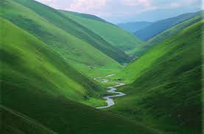
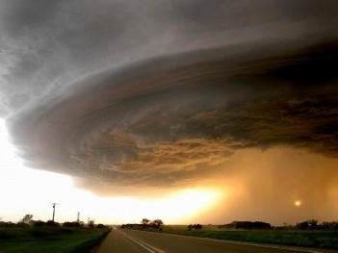
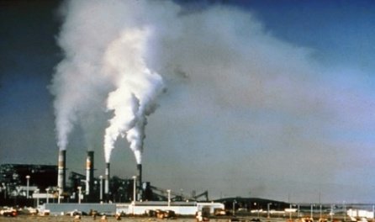
What makes air dirty?
Factors Affecting Air Quality
Weather
Physical and Chemical properties
Emission of pollutants
Topography
Burning of fossil fuels
  Coal, oil, natural gas, gasoline or diesel
Everyday activities
  Cooking, washing at home or travelling by cars
Increasing importance of vehicle emissions
Notes:
Generally, air pollution comes from the burning of fossil fuels such as coal, oil, natural gas, gasoline or diesel …
There are several factors affecting air quality: the weather, temperature, and topography (there are different conditions living in a prairie than in a valley)
In the atmosphere there are no limits or boundaries, once those pollutants are emitted everything reacts with everything and the physical and chemical properties are important.
Then the activities we do, and actions we take will not only affect our region but could affect some other places and even have an impact on climate change.

Slide 5



Air pollution today
When we think of air pollution, we should also think of transportation, especially cars
169,000 vehicles registered in the Central Okanagan Region (2022)
90,000 + vehicles are on the road on a typical weekday.
The gases emitted can be very dangerous to children
Central Okanagan
GHG emissions
Vehicles (63%)
Buildings (31%)
Waste (6%).
Notes:
In 2007, open burning and residential wood burning were identified as the main causes of degraded air quality in Central Okanagan. But in 2010, vehicles were the cause of 63 % of greenhouse gas (GHG) in Central Okanagan.
ICBC 2022:124,095 personal vehicles and 45,182 commercial vehicles= 169000+
The 169,000 includes registered cars from Peachland, Lake Country, West Kelowna and Kelowna. Source ICBC 2022.
The fuel that all those 169,000 cars use – gasoline and diesel – causes bad gases to be ejected from the exhaust. These gases are very dangerous, particularly to children.
Burning 1 L of gasoline produces approximately 2.3 kg of CO₂
Source :http://www.nrcan.gc.ca/energy/efficiency/transportation/cars-light-trucks/buying/16770

Slide 6
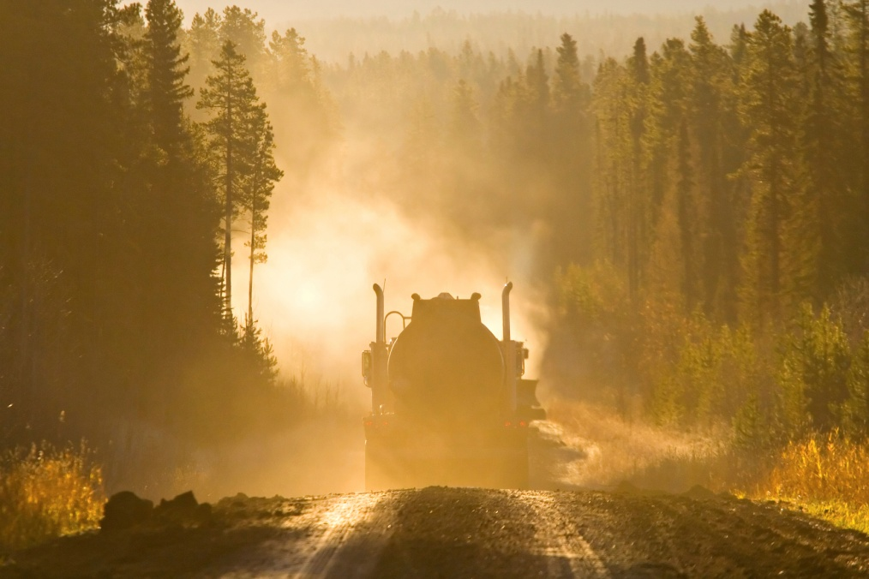
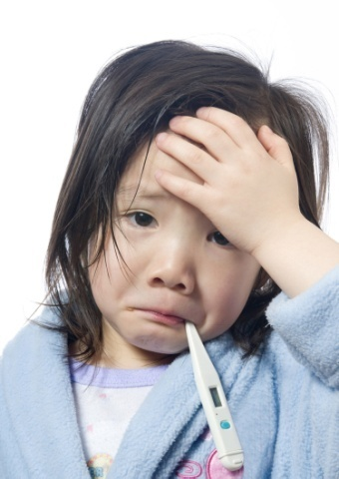
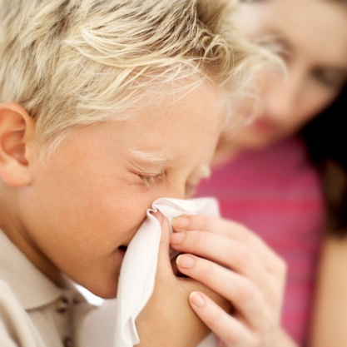
How does air pollution affect you?
Air pollution causes breathing problems, lung and heart diseases, such as asthma
Children are particularly at risk, air pollution can:
  Affect your immune system
  Make you cough, splutter, wheeze, sneeze, feel dizzy and it can make your eyes itch
  Tiny particles of dust from woodstoves can affect your health.
Notes:
We come into contact with many kinds of air pollutants every day.
They are being released in our neighbourhoods, our backyards, and inside our homes, and are finding their way into our lungs. Outdoor pollutants seep into houses, even through closed doors and windows.
Causing breathing problems, lung and heart diseases, such as asthma.
It is estimated that 1,600 premature deaths in B.C. in the calendar year 2015 can be linked to above-background air pollution (fine particulate matter, nitrogen dioxide and ozone) from all sources
For example, the tiny particles of dust from woodstoves can also affect your health. Click on the 31 seconds video!

Slide 7
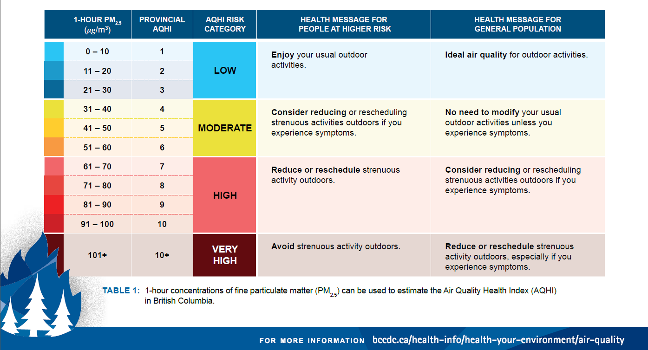

How do we know if the air we breathe is clean?
Air Quality Health Index or "AQHI“ is measured on a scale ranging from 1-10+
Check the Central Okanagan Air Pollution levels!
Get the AQHI Canada app
to stay informed
Source- BC Centre for Disease Control
Notes:
The Air Quality Health Index or "AQHI" is a scale designed to help you understand what the air quality around you means to your health.
Usually, the Central Okanagan Region has an Air Quality Index between 1-3. Except during wildfires.
You can go online and Check the Central Okanagan Air Pollution levels! for the day at:
http://weather.gc.ca/airquality/pages/bcaq-008_e.html
One of the best ways to stay informed is to download the AQHI Canada app and set up notifications for alerts when the AQHI in your community reaches the level at which you wish to be notified.
To learn about the Ministry’s monitoring station located at RDCO KLO Rd., check the Small low-cost air quality sensor pilot project Current air quality - Regional District of Central Okanagan (rdco.com)

Slide 8
Where are the pollutants?
The main causes of air pollution in B.C. are fossil fuel combustion and wood burning
Carbon Monoxide
CO
Particulate matter PM2.5 &PM10
Other Pollutants
Sulphur Dioxide SO2
Nitrogen dioxide NO2
Invisible gas that is a fast-acting poison
Higher concentrations can cause impaired vision and coordination, headaches, dizziness, confusion, nausea
Heart and lung disease
Ground level Ozone O3
Are tiny particles of dust and soot that can penetrate deep into our lungs
Coughing and wheezing
Cancer, lowered immunity, disorders of the nervous system, and interference with child development
Worsen asthma
Is a colourless, odourless gas made of three oxygen atoms
Irritate the eyes, nose and throat and the lung airways
Sulfur dioxide is a colorless gas with a pungent and suffocating odor
Notes:
The main pollutants in the Central Okanagan are Ozone (O₃), Nitrogen Oxides (NOx) and Fine Particulate matter (PM_{2.5})

Slide 9
Ozone (O3)
1-High up in the atmosphere
When this gas is up high in the ozone layer it’s “good” ozone and acts like sunscreen for the Earth.
2-Right down at the ground.
When it’s near the ground it’s “bad” ozone.
“Ground-level ozone” can affect our environment and our economy by damaging ecosystems and vegetation and accelerating global climate change.
Notes:
To explain the ozone layer, you can also share a 2:59 min video
What is the Ozone Layer? - Environment For Kids | Mocomi
When this gas is up high in the ozone layer it’s “good” ozone and acts like sunscreen for the Earth – blocking out most of the Sun’s harmful ultraviolet rays.

Slide 10
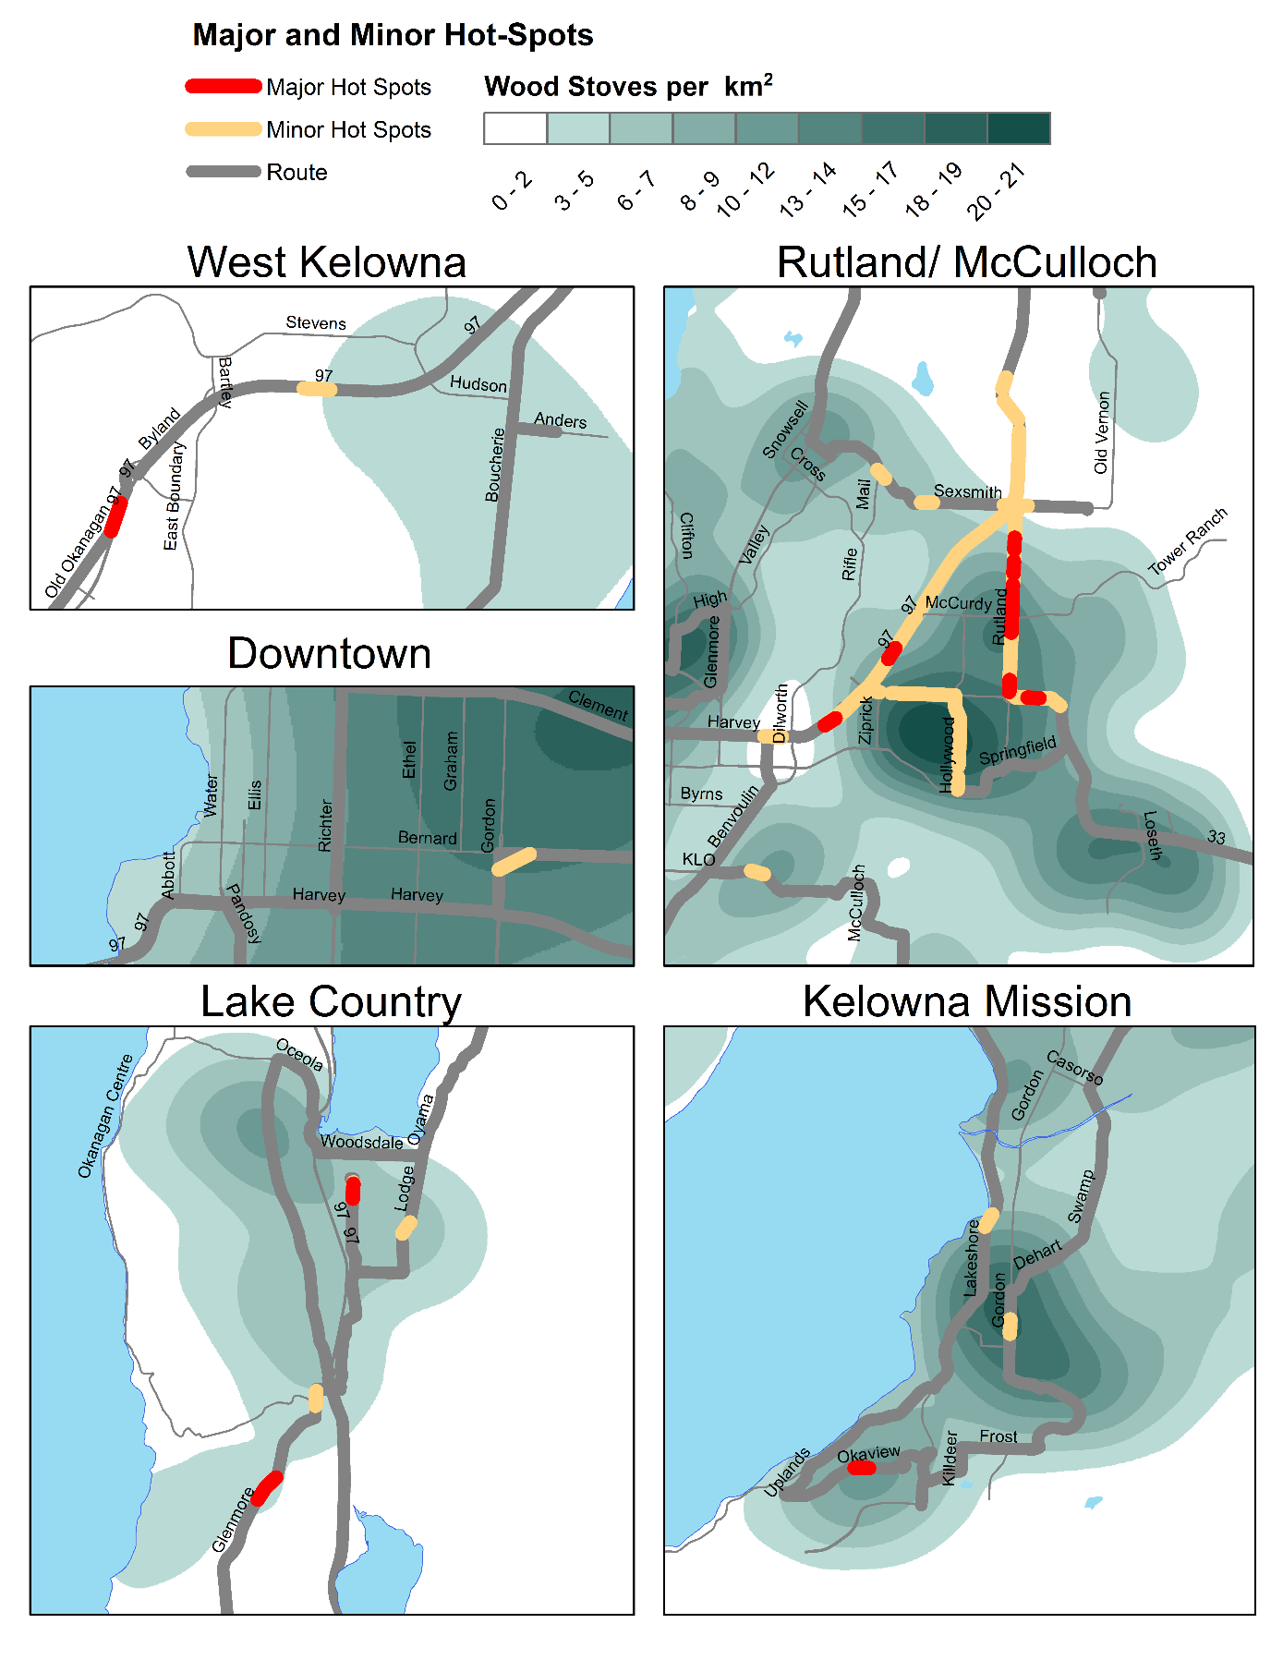
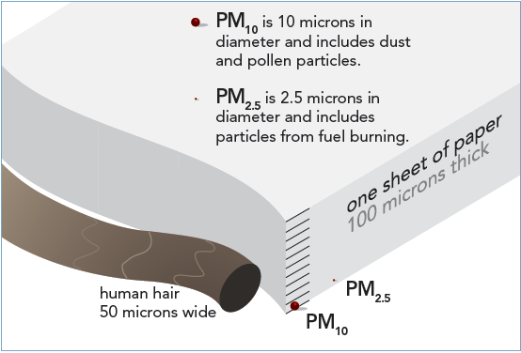
Where are the pollutants?
Everywhere!
Too small to see without a microscope
  they still get into our lungs and affect our health
Higher concentrations of fine particulate or “Hot-spots” are mainly due to:
  Fuel combustion (use of vehicles)
  Wood burning (from wood appliances and open burning)
Notes:
Fine particulate is one of the pollutants of concern in the Okanagan.
Fine particulate consists of particulates with diameters that are less or equal to 2.5 microns in size.
The size comparison will give the students a better idea of how small is PM2.5
A recent mobile study in the Central Okanagan (2015-2016) showed that certain neighbourhoods had higher concentrations of fine particulate (PM2.5) due to wood smoke and traffic
This mobile monitoring study was performed through a specific route. The route was completed 26 times during November 2015-April 2016. Those neighborhoods had consistently higher concentrations of PM2.5 during that sampling.
It is estimated within the Central Okanagan region are between 4000-12000 wood appliances in use- Source Ministry of the Environment
The region is working on several policy changes to encourage the exchange of old wood-burning appliances (for more efficient ones) and is promoting better wood-burning practices among other activities.
If the students use a wood appliance to heat their home, encourage them to tell their parents to visit the RDCO webpage to find out about “best wood burning practices”.
High-efficiency units allow you to burn a third less wood and get the same amount of heat. Advanced technology stoves mean less smoke, less work and big cost savings. The wood should be dry; the moisture content of the wood should be under 20%, preferably around 15%. Moisture meters allow you to test the moisture level in wood, are available in stores and can cost as little as $20.
Regional District of Central Okanagan

Slide 11
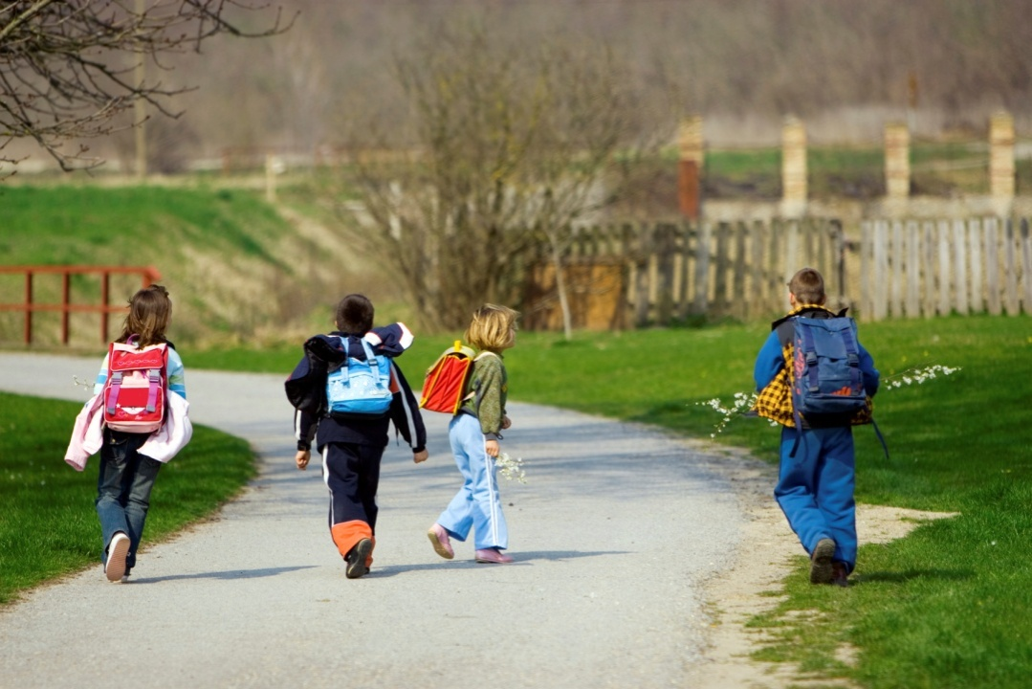
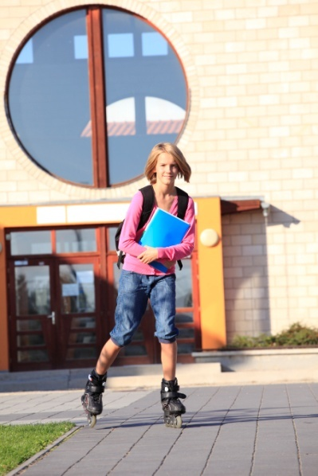

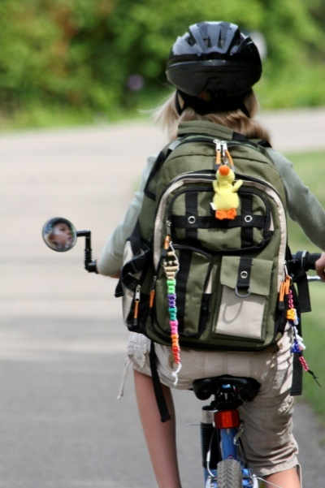
Everyone can help make our air cleaner!
Walk or roll to school!
  It is good exercise and can reduce air pollution
  Watch the Pedestrian Safety video
Use public transport
  take the bus instead of riding in the car
If you must travel to school by car:
  try car-sharing with other friends
  Park a few blocks from school and walk
www.smarttrips.ca
Notes:
Hands up! Who walked/rolled or carpooled to school today?
For more Cycling Resources, Maps - Cycling, Walking, Hiking Pathways and Trails you can go to:
smartTRIPS |
Use your safe Route to school map
Safe routes 4 schools - Regional District of Central Okanagan (rdco.com)

Slide 12
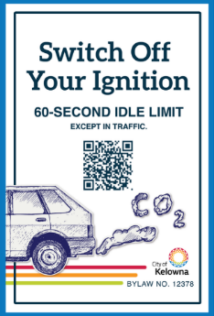

Everyone can help make our air cleaner!
4. Stop idling
When people leave their car engine running while they have stopped, this is called ‘idling’.
Turning off the engine could reduce air pollution and save your parents some money!
City of Kelowna’s one-minute Idling Control 12378 in effect since July 25, 2022.
Save fuel
and money!
Tell your parents!
If you’re going to be stopped for more than 60 seconds
- except in traffic –
Please Turn the engine off
Notes:
You can make your own estimations based on the number of students in the class. Use the QR code to estimate fuel and money savings or go to Idling Fuel and Money Estimator (jotform.com)
If we assume:
Cost per litre= $1.4
25 kids per group, therefore 25 parents sign the Idling Reduction Pledge.
If 25 driver(s) of light-duty vehicles avoided idling for 6 minute(s) a day, the group contributions will be:
Reduce the use of 1,643 litres of fuel per year
Save $2,300 annually
Reduce 3,778 kilograms of GHG emissions per year
Equal to taking 1 vehicle(s) off the road
Each driver would save 66 litres of fuel, $92 in fuel costs, and contribute to the reduction of 151 kilograms of GHG emissions, annually

Slide 13

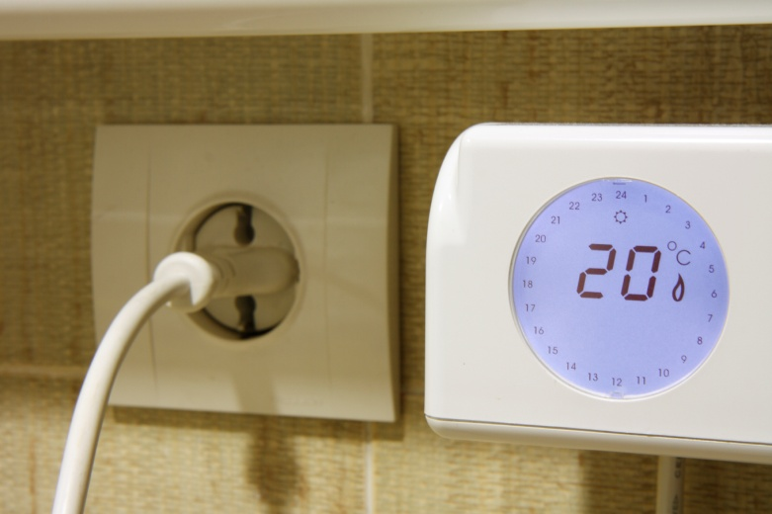


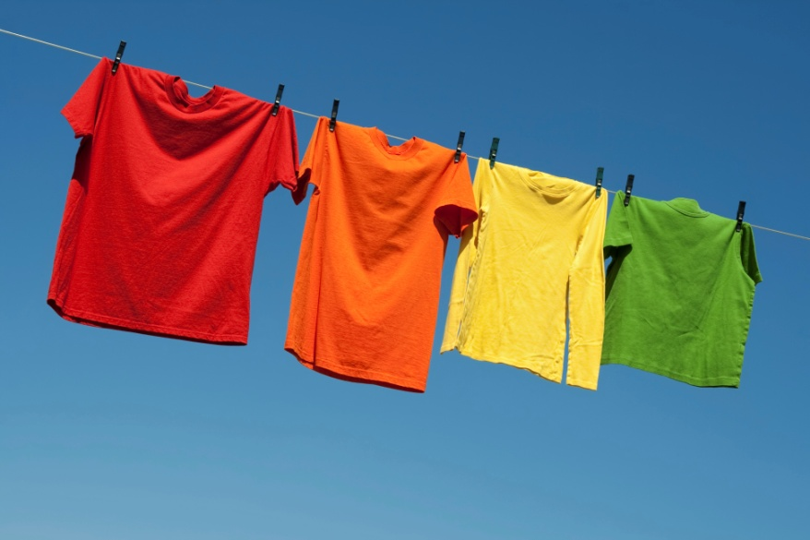

Everyone can help make our air cleaner!
5. Spread the word!
  Discuss air quality issues with your teachers, friends and family
  Make sure everyone you know is aware of the dangers of air pollution
6. Simple actions at home!
  Set the thermostat at the lowest comfortable temperature within an average of 18°C and 21°C
  Turn off the lights, TV or computer when you don’t need them
  Tell your parents to wash your clothes in cold water and hang them out to dry instead of using a dryer, when they can
  Choose cleaner and more efficient heating devices. EPA emissions-certified wood appliances and heat pumps are cleaner ways to heat a home.
  Recycle!
Notes:
These simple actions can reduce CO2 emitted which contributes to air pollution.
For more ideas, you can go to :
what_can_individuals_do_combined-revised_2023.pdf (smarttrips.ca)
A fact sheet will be sent home later to remind you and your parents how everyone can help to keep our air clean.

Slide 14
If you want to learn more visit: rdco.com/airquality
Regional Air Quality Program
c/o City of Kelowna Regional Services
1435 Water Street, Kelowna, BCV1Y 1J4
Ph. 250-469-8408
airquality@kelowna.ca

